Slide 1
Unit Test And DCAF
Notes:
based on materials by M. Ernst, S. Reges, D. Notkin, R. Mercer, Wikipedia

Slide 2
Unit Test – Do I Need It?
Do I ever make a mistake?
Do my colleagues?
Really?
No
No
Yes
Yes
YES
Notes:
Some of you may not be sold, so I offer you this handy flow chart to determine if your project can benefit from Unit Test.
We’ve all been there at some point, “branching” our code and saving copies by renaming zip files; we’ve all experienced the frustration and potential for accidently modifying the wrong files when using this method. Overall, we should all recognize that it’s very very bad.
For more details on source code control in LabVIEW, please see Eli Kerry’s Software Engineering Technical Manual and Exercises for LabVIEW: https://decibel.ni.com/content/docs/DOC-10122

Slide 3
Agenda
What is DCAF
DCAF Workflow
DCAF Development workflow
LabVIEW Unit Test Framework
DCAF Unit test
Notes:
The pruspose of this session is to give a quick introduction to unit test, as well as how it is applied in DCAF.

Slide 4

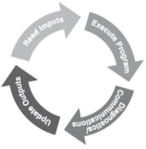
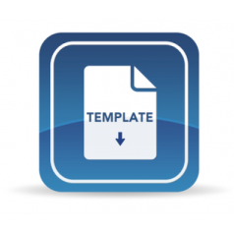





Distributed Control and Automation Framework (DCAF) Overview
An open-source LabVIEW framework for creating configurable, latest value, data engines that can acquire data from multiple input sources, process that data, and then route it back to outputs or to data services.
Create higher quality control applications, in less time.
Scalable and extensible plugin
architecture
Develop with plugin templates
Reuse existing plugins
Define and configure plugin
parameters
Single point I/O, processing, and
data services
Rules for correct-by-construction
software
Configure timing and error handling
Optimized for real-time execution
Notes:
The Tag Bus Data Framework or TBDF is an open-source LabVIEW framework for creating configurable, latest value, data engines that can acquire data from multiple input sources, process that data, and then route it back to outputs or to data services. It provides a scalable and extensible plugin architecture. It supports users in the development of new plugins with a variety of templates… …and the framework was designed to allow plugins to be reused easily across projects. Reuse is easy because each plugin can define configuration parameters which can be specified using a configuration editor. This also allows plugin behavior to change across multiple deployments of the same application. While applicable to a wide variety of use-cases, the framework was primarily built for applications using a lot of single point I/O: things like control data or industrial communication protocols. The plugin architecture helps facilitate multideveloper teams, and the framework handles the intricacies of execution timing and error handling for its users. Finally, while the framework can run on RT, Windows, and Interact with FPGAs, it was built primarily for applications executing on a real-time OS.

Slide 5
DCAF Engine
Engine
Init
Input
Process
Output
Close
Input
Process
Output
Input
Process
Output
Outside
Outside?
Outside
Editor
Engine
Modules

Slide 6
DCAF Components
Project Templates
Configuration
Runtime
Templates
Configuration Editor
Engine
Examples
Modules

Slide 7
2 min DCAF Demo

Slide 8
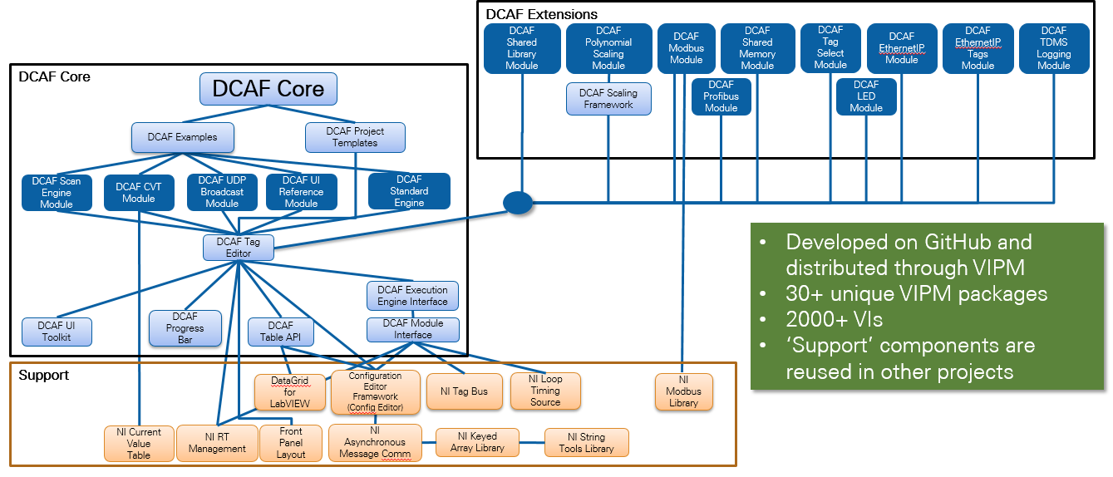
DCAF Package Dependency Diagram

Slide 9
DCAF Challenges
Large Code Base
Multiple developers
Multiple independent releases
External Collaborators

Slide 10



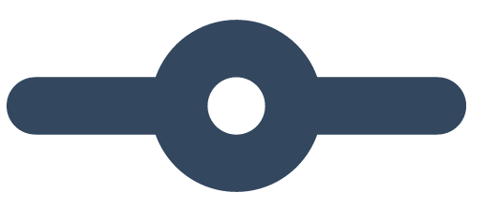

Developer Workflow
!
✓

Slide 11
Last Link in a Continuous Delivery Chain
Publish to SFTP
Checkout source code
Unit Test
Build
Publish to Unstable
Integration Test
Manual Check
Publish to Box
Publish to GitHub
…

Slide 12
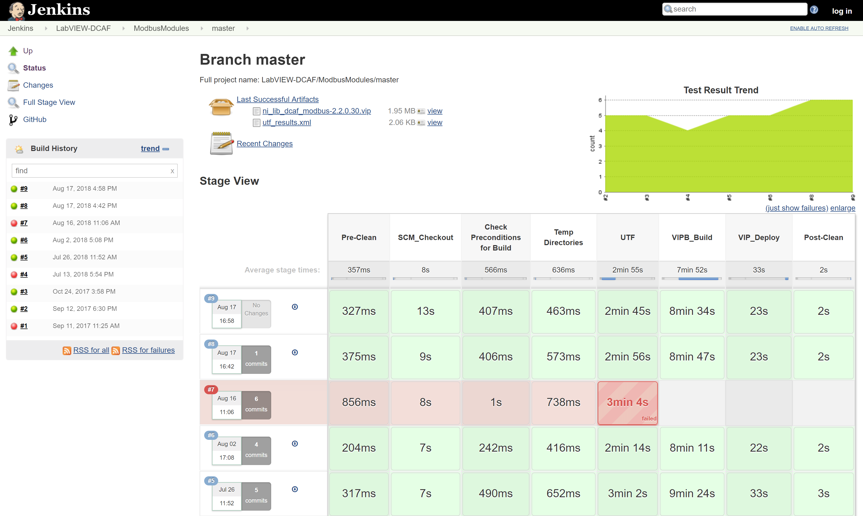
Continuous Integration

Slide 13
What is a Unit Test
Unit Testing: Looking for errors in a subsystem in isolation.
Integration Testing: Looking for errors when 2 or more subsystems are working together.
System Test: Looking for errors ALL the components in the final configuration including integration with other software and hardware.
Notes:
Generally a "subsystem" means a particular class or object.

Slide 14
Regression testing
regression: When a feature that used to work, no longer works.
Likely to happen when code changes and grows over time.
A new feature/fix can cause a new bug or reintroduce an old bug.
regression testing: Re-executing prior unit tests after a change.
Often done by scripts during automated testing.
Used to ensure that old fixed bugs are still fixed.
Gives your app a minimum level of working functionality.
Many products have a set of mandatory check-in tests that must pass before code can be added to a source code repository.

Slide 15
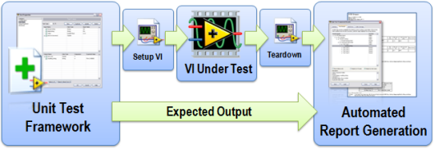
LabVIEW Unit Test
Notes:
http://www.ni.com/white-paper/8082/en/

Slide 16
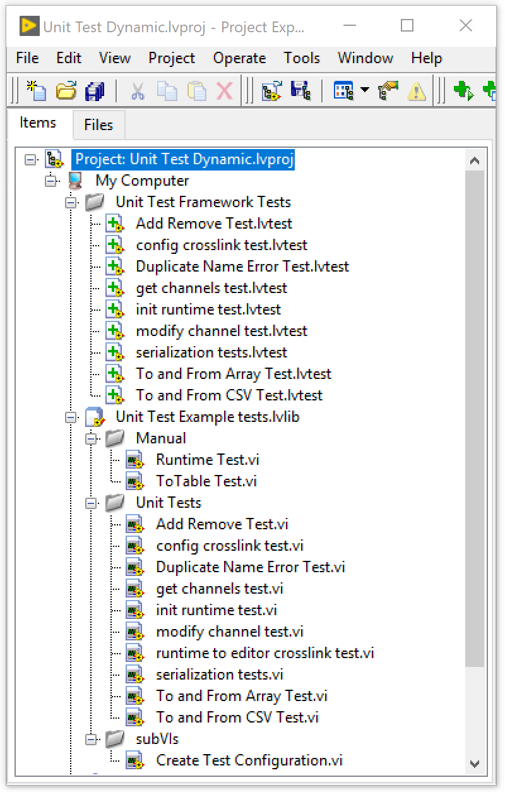
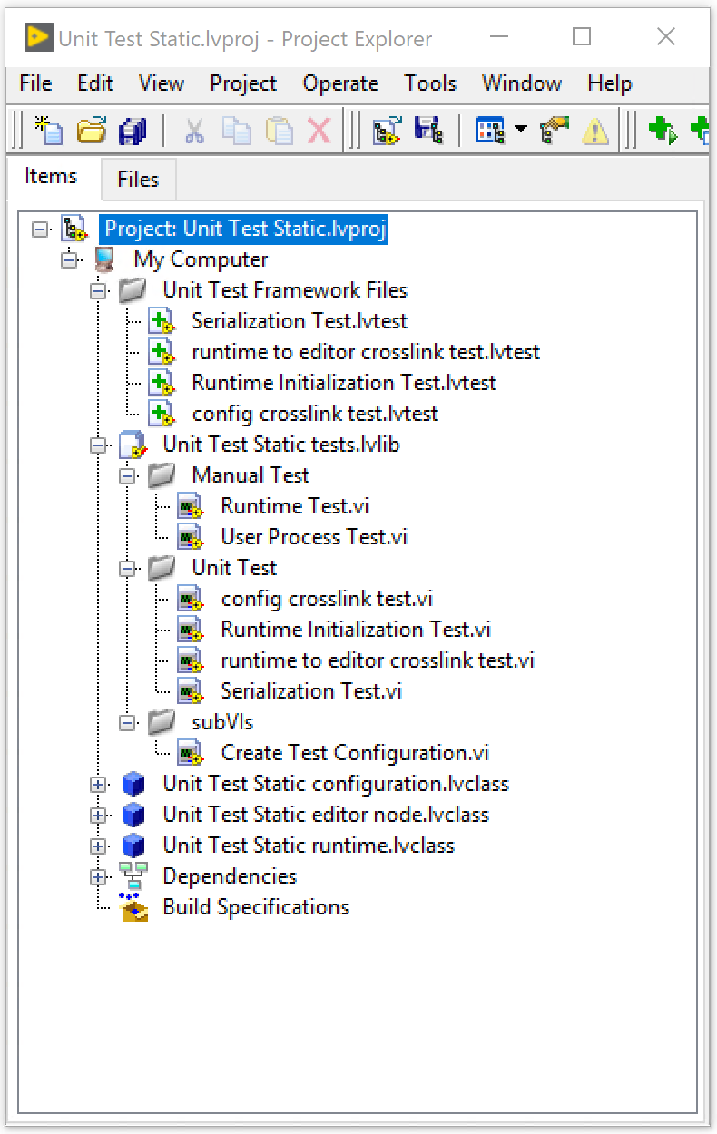
Unit Test In DCAF
Notes:
Templates already include some unit test that you can modify we are going to cover some of the most common ones as well as explain what we are doing .

Slide 17
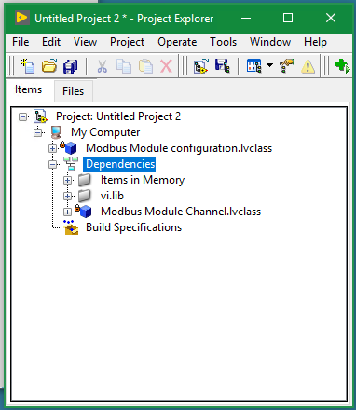
Cross Link Test
Configuration
Editor node
Runtime

Slide 18
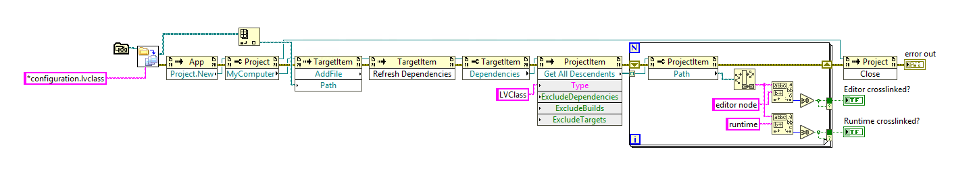
Crosslink Test

Slide 19
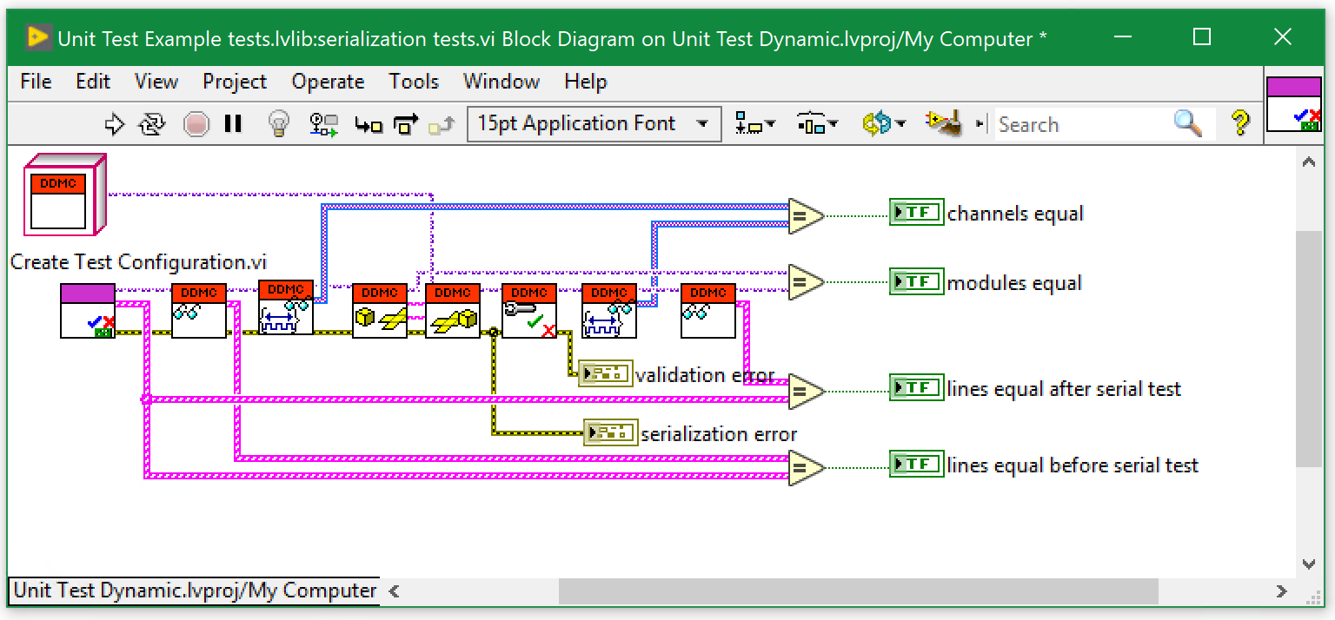
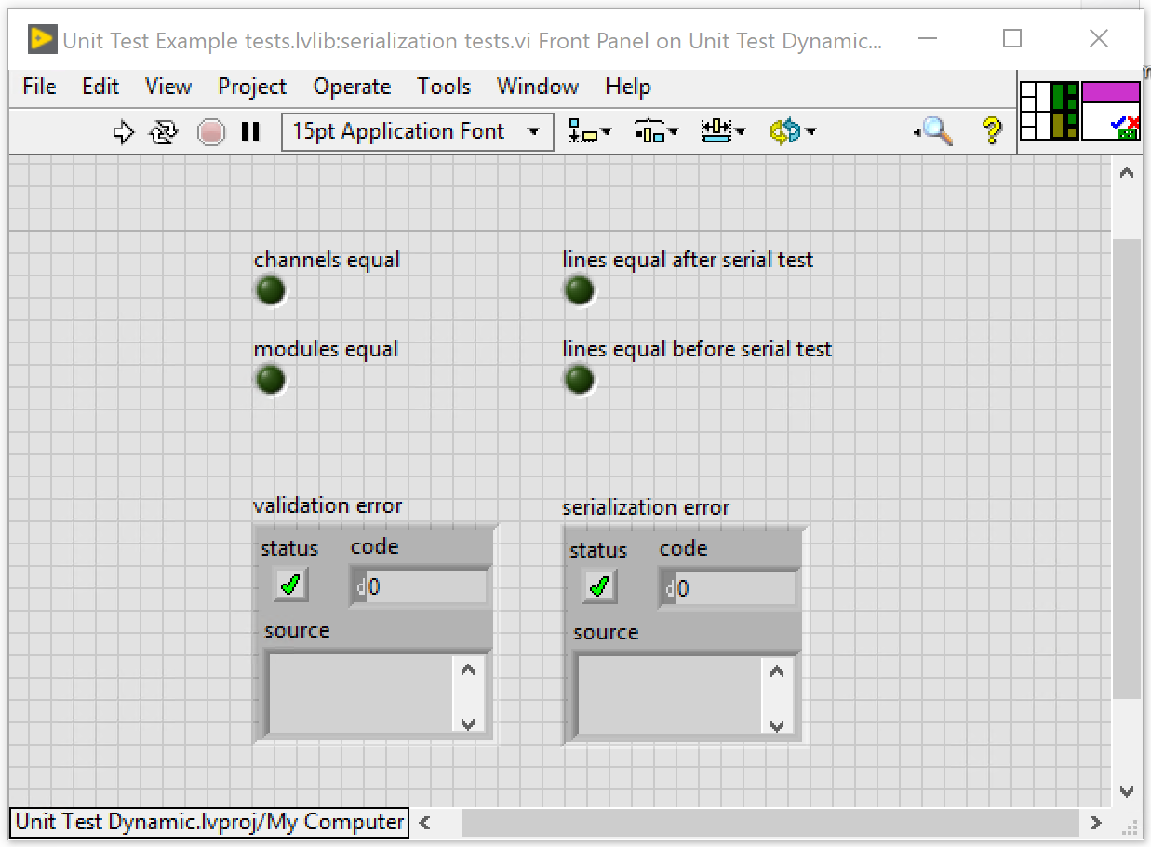
Serialization Test

Slide 20
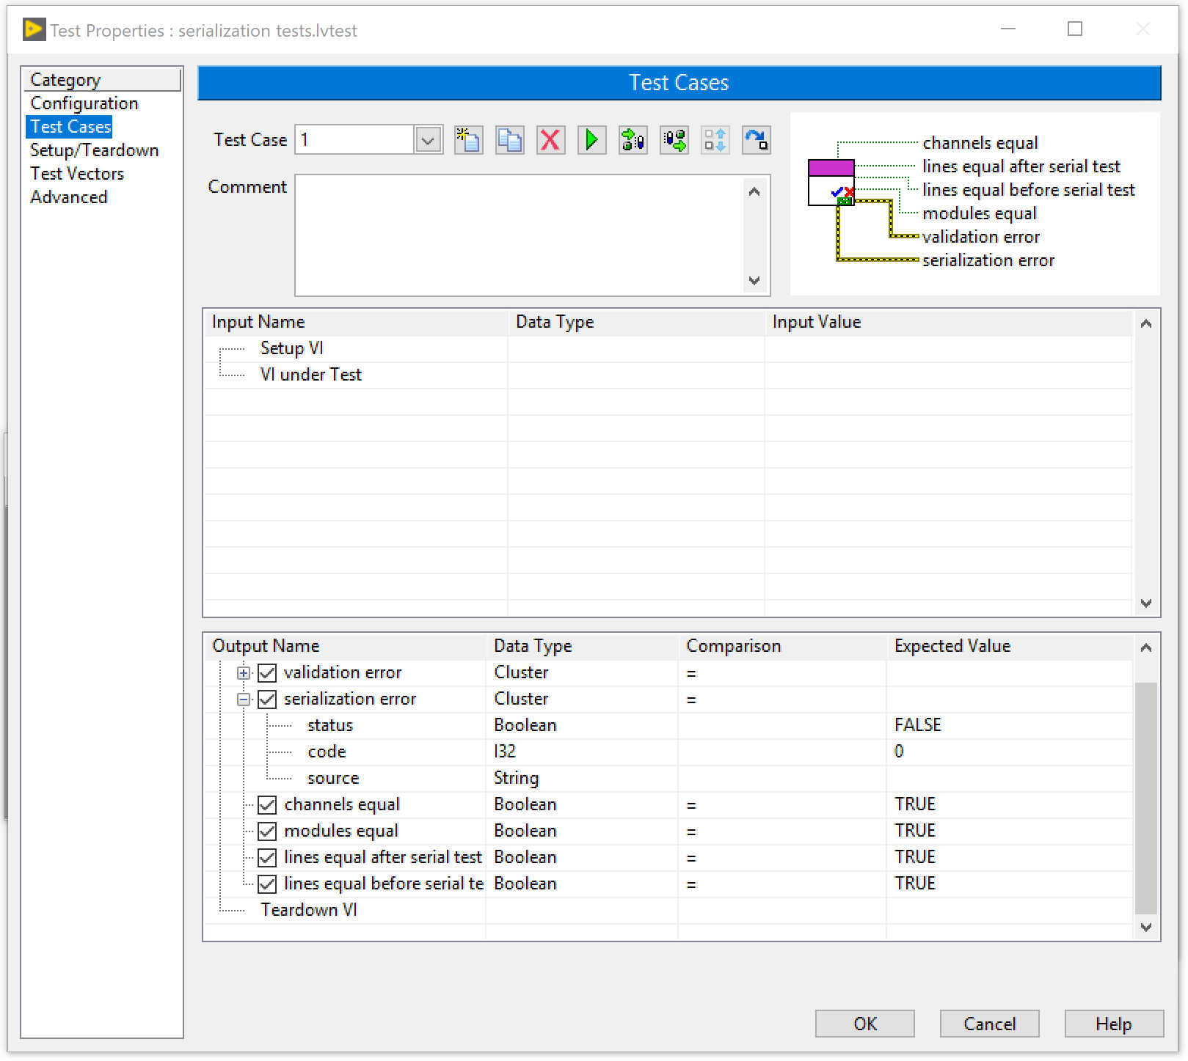
Serialization Test

Slide 21
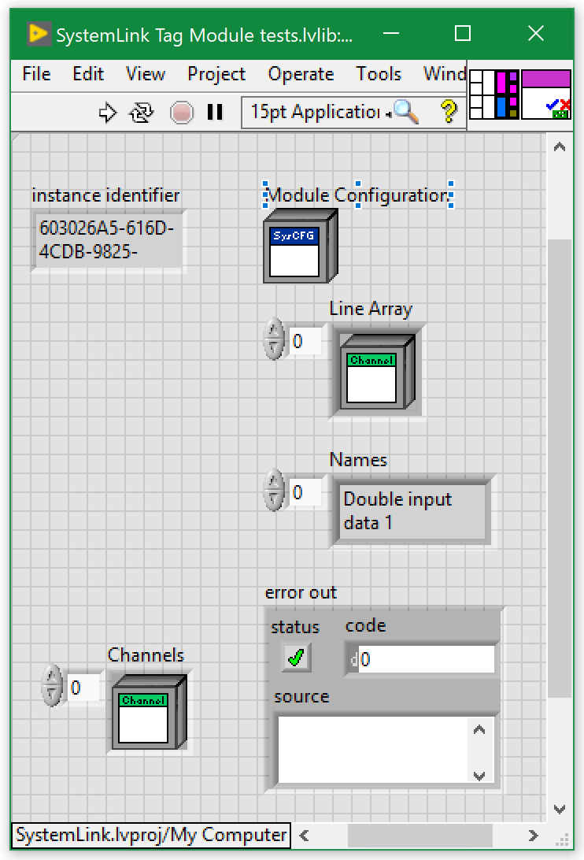
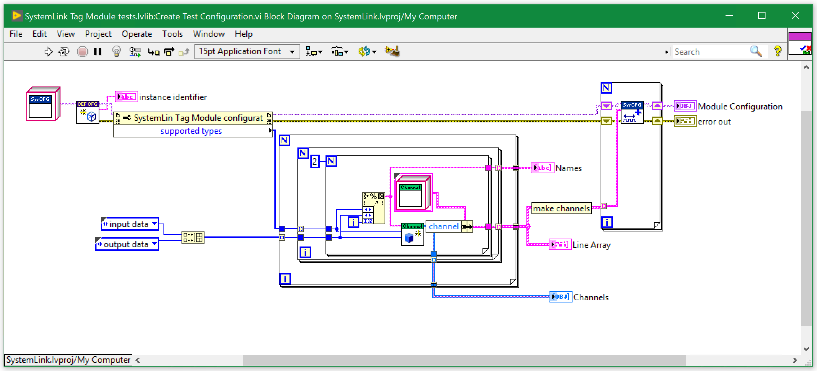
Create Test Configuration

Slide 22
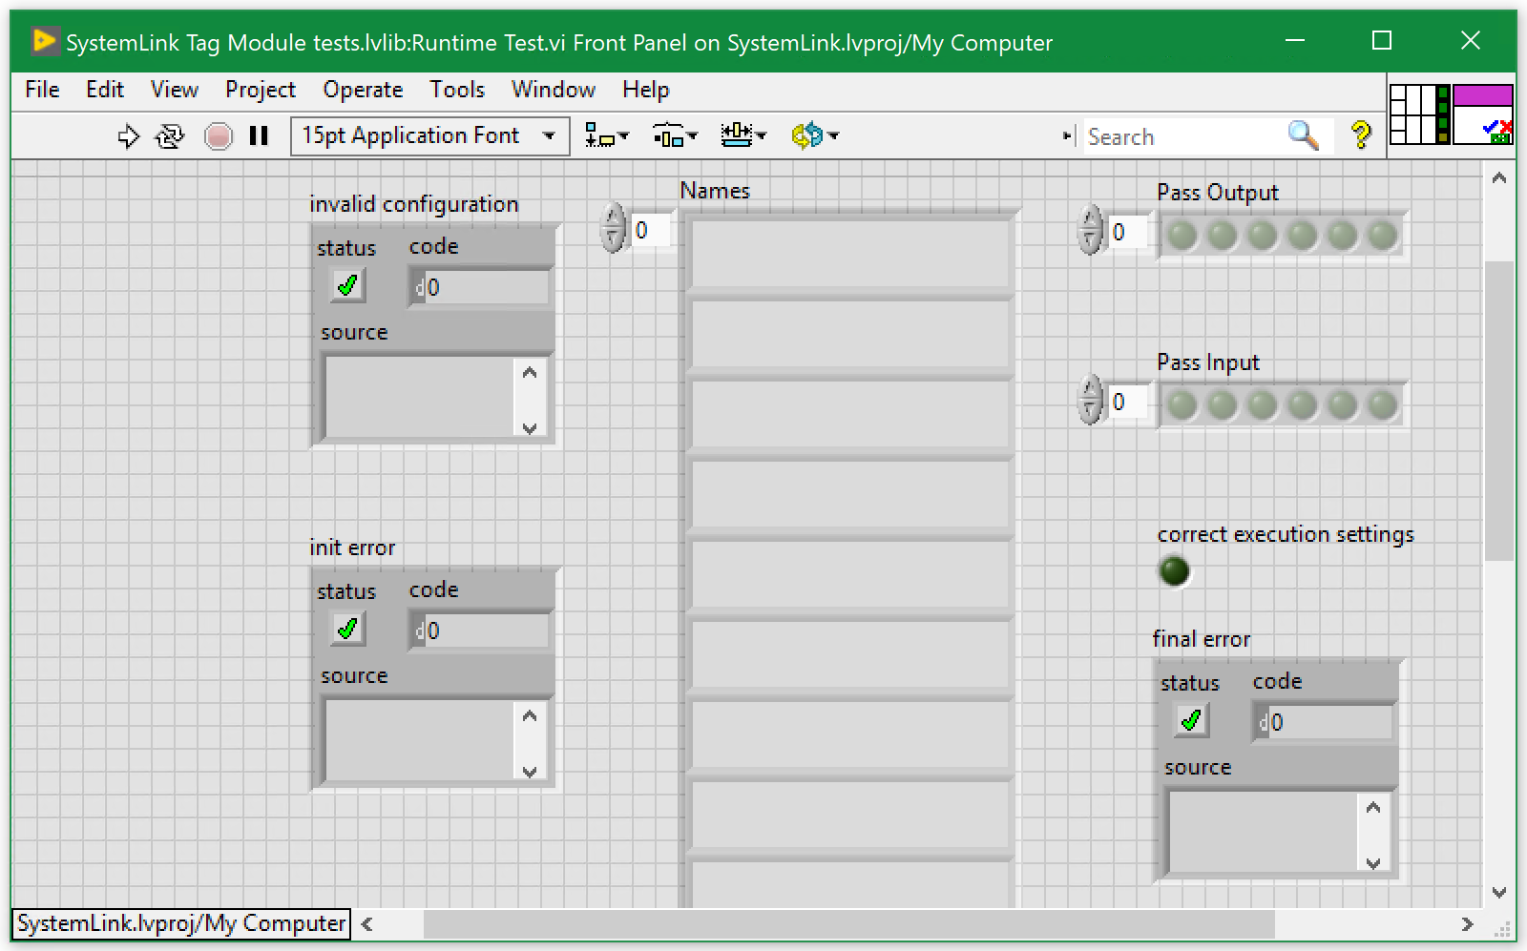
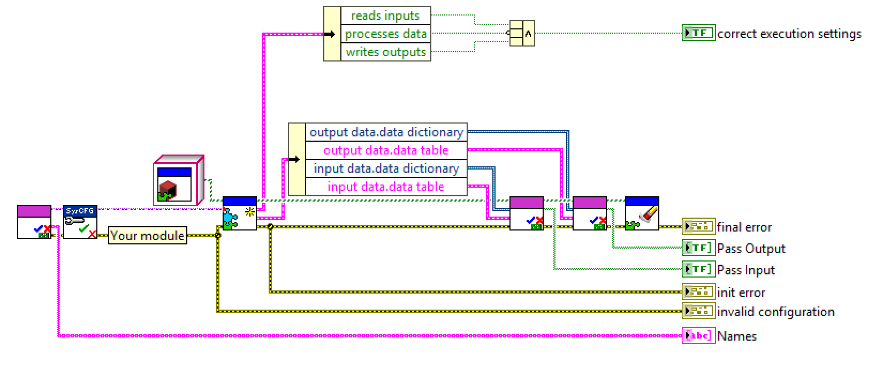
System Link Runtime Test

Slide 23
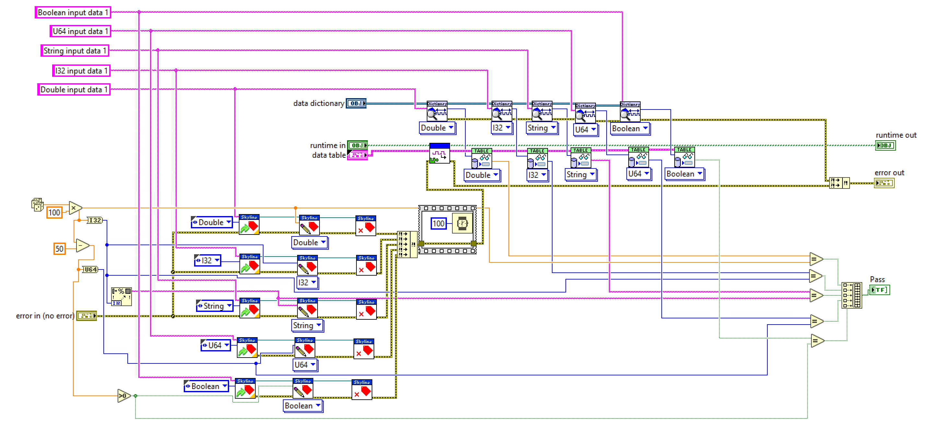
Read Test from the Runtime test.

Slide 24
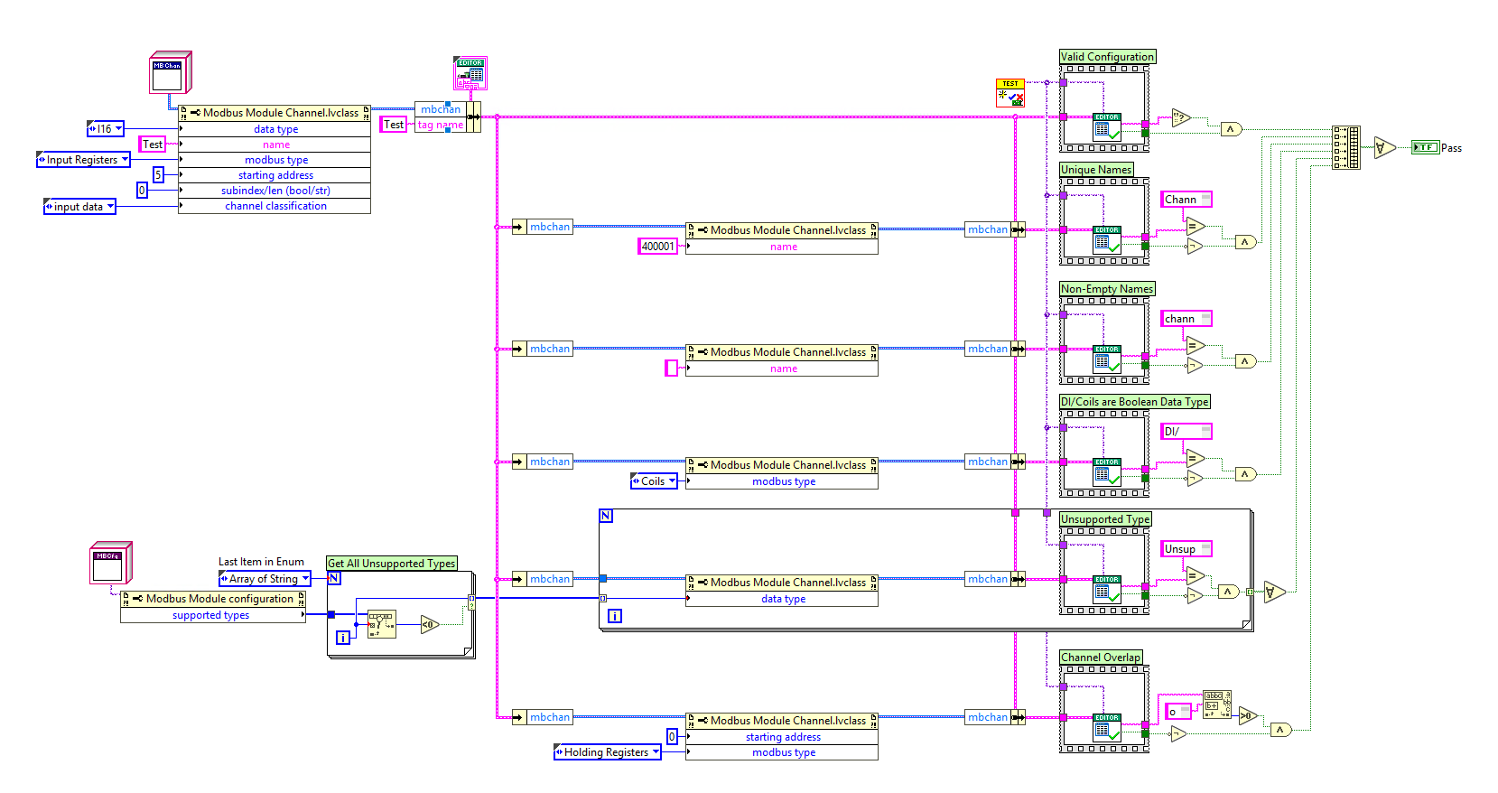
Modbus Validate Line Configuration

Slide 25
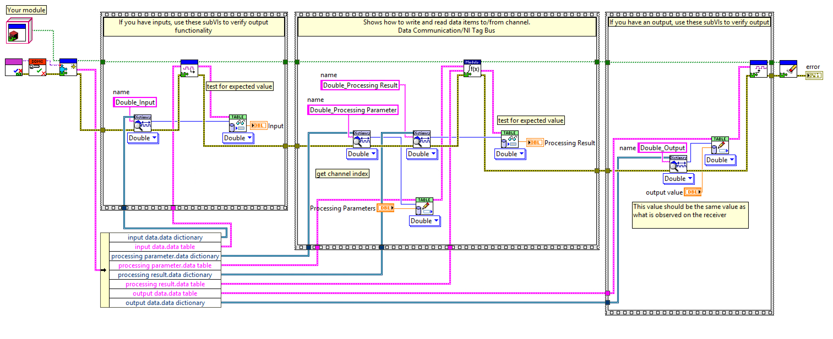
Runtime Test

Slide 26
Didn’t we fix this bug before?
You are never done testing.
If you find a bug:
Create unit test before fixing the bug.
Fix the bug.
Run your test.
Notes:
During development new bugs will be found
You should create new unit test that test bugs.
You should create the test before the bug is fixed

Slide 27
Conclusions
You can NOT Test everything, so choose wisely.
You can NOT do proper testing without requirements
Testing adds overhead but reduces time spent in debugging.
Test automation allows us to run unit test in a consistent way
Using a unit test framework allows automation.
Don’t Test In Production.
Make Time for testing.

Slide 28
Introduction to Unit Test

Slide 29
So why people don’t use it
Perception by some developers and managers:
Testing is seen as a novice's job.
Assigned to the least experienced team members.
Done as an afterthought (if at all).
"My code is good; it won't have bugs. I don't need to test it."
"I'll just find the bugs by running the client program."
Limitations of what testing can show you:
It is impossible to completely test a system.
Testing does not always directly reveal the actual bugs in the code.
Testing does not prove the absence of errors in software.

Slide 30
Unit Test and Flossing
People don't know how to do it correctly (and doing it incorrectly was painful)
People aren't using the right tools for the job (wrapping floss around their fingers when they could use a simple flossing stick)
People don't believe that they have enough time to do it (it doesn't fit their workflow)
Notes:
http://www.labviewcraftsmen.com/blog/do-you-unit-test

Slide 31
Why to Do Unit Test
Make sure the blocks works before looking at the system.
Find Bugs Early
Regression testing

Slide 32
Test-driven development
Unit tests can be written after, during, or even before coding.
test-driven development: Write tests, then write code to pass them.
Write code to test this method before it has been written.
Then once we do implement the method, we'll know if it works.

Slide 33
What should we test
Everything????
Nothing
Public APIs

Slide 34
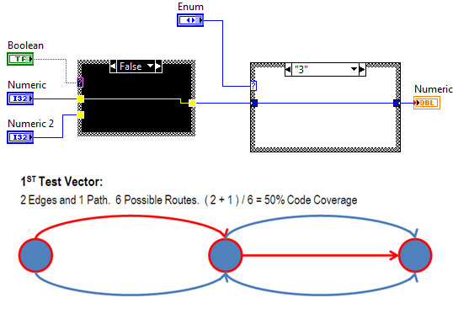
Code Coverage

Slide 35
Demo
Notes:
Demo Create a Stump or code to call and test our code.
Create a test VI.
Compare value to expected value
Explain Set Up and Tear down.

Slide 36
What do we need to test?
Requirements
Time
Automation

Slide 37
Unit Test Frameworks

Slide 38
Automation - Test
Source control providers include hooks to continuous integration services
Automatically run all build/test operations on every commit
Track unit test results to a particular commit of files
Make sure that you didn’t break it
Require commit to pass all tests before it can be merged
Prevents one developer’s mistake from hurting everyone
Don’t be that guy

Slide 39
Demo 2
Notes:
1 Create a Unit Test for Our VI
2 create a Unit Test based on the Demo 1 test VI.

Slide 40
Other Unit Test Frameworks.
JKI Caraya
JKI VI Tester.
Notes:
JKI VI Tester
JKI Caraya

Slide 41
Unit Test In DCAF

Slide 42
Set Value for tags
Execute input of the module
Compare values read
Against Expected Values

Slide 43
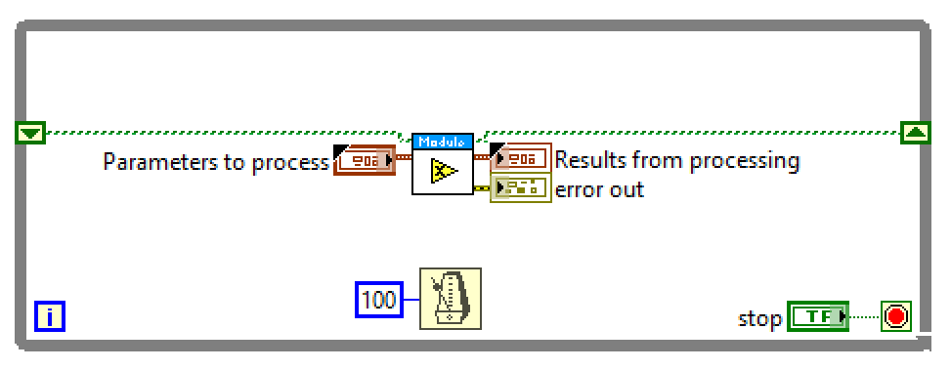
User Process Test

Slide 44
General Guidelines and Tips

Slide 45
Requirements
It is impossible to completely test a system.
You need requirements to know what you need to test.
Granular requirements make easier to figure adequate tests.

Slide 46
Tips for testing
You cannot test every possible input, parameter value, etc.
So you must think of a limited set of tests likely to expose bugs.
Think about boundary cases
positive; zero; negative numbers
right at the edge of an array or collection's size
Think about empty cases and error cases
0, -1, null; an empty list or array
test behavior in combination
maybe add usually works, but fails after you call remove
make multiple calls; maybe size fails the second time only

Slide 47
Tips for testing
Test one thing at a time per test method.
10 small tests are much better than 1 test 10x as large.
Each test method should have few (likely 1) assert statements.
If you assert many things, the first that fails stops the test.
You won't know whether a later assertion would have failed.
Tests should avoid logic.
minimize if/else, loops, switch, etc.
avoid try/catch
If it's supposed to throw, use expected= ... if not, let JUnit catch it.
Torture tests are okay, but only in addition to simple tests.

Slide 48
Tips for testing
Tests should be self-contained and not care about each other.
Constrained test order : Test A must run before Test B. (usually a misguided attempt to test order/flow)
Tests call each other : Test A calls Test B's method (calling a shared helper is OK, though)
Mutable shared state : Tests A/B both use a shared object. (If A breaks it, what happens to B?)

Slide 49
More Resources
http://www.labviewcraftsmen.com/blog/do-you-unit-test
https://courses.cs.washington.edu/courses/cse331/11sp/lectures/slides/09-junit.ppt
http://www.cs.washington.edu/331/
Notes:
https://www.youtube.com/watch?v=e2Poh0bzcwk

